Slide 1
MIPS 3
Julia abbott
Jude battista

Slide 2
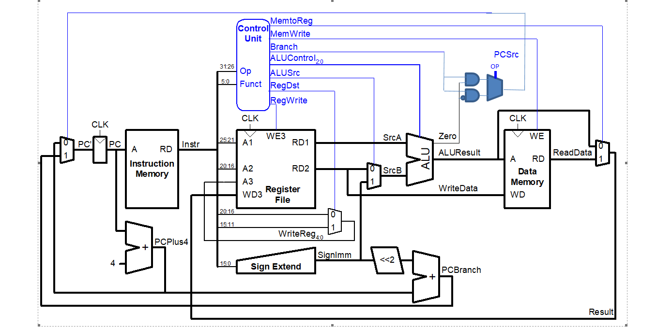
Changes made

Slide 3
Mips test program
addi $4, $0, 1 # mov 1 into $4
addi $5, $0, 1 # mov 1 into $5
bne $4, $5, end # should do nothing since $4 and $5 are equal
addi $5, $5, 1 # add one to $5, making it not equal to $4
bne $4, $5, testXori # should branch to the testXori section, skippingthe jump to end
j end # skip the testXori section
testXori:
addi $4, $0, 3 # Set $4 to three
xori $5, $4, 6 # Do an xor with $4 = 3 and 6, should be 5 (...0011 XOR ...0110 = 0101 = 5)
end:

Slide 4


Slide 5
Vhdl chagnes
Imem1
signal mem: ramtype := InitRamFromFile("memfile_3.dat");
Md:maindec
when "001110" => controls <= "101000011"; --XORI
when "000101" => controls <= "0X010X001"; -- BNE
Ad:aludec
when "10" => alucontrol <= "011"; --xori
Mainalu:alu
a xor b when "11",
Cont: controller(struct)
pcsrc <= branch and not zero when op = "000101" else branch and zero;

Slide 6
process
Paired Programming
Assembler encryption and decryption
Turns out, your controller needs opcodes for the new instructions. Who knew?
Simulation periodically failed to acknowledge altered instruction set.
Yes, we tried that.
Simulation and FPGA results in agreement.

Slide 7
result
Yay?
We considered adding additional features.
We did not add additional features.
the current boss was tough enough without giving it power-ups.

